Slide 1

Air Traffic SDR
Bryan Burke,
Gavin Li,
Mukhtar Suleman

Slide 2
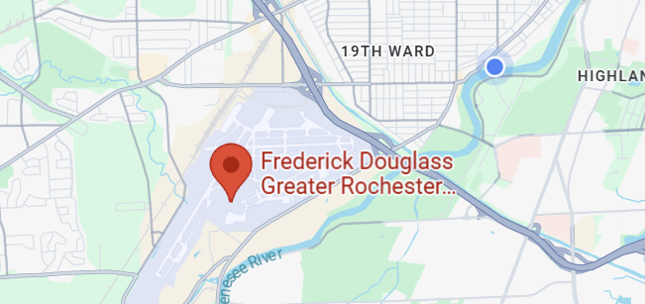
Problem Statement
The theme of the project was to implement a software defined radio to listen in on conversations between air traffic and air traffic controllers around the Frederick Douglass Greater Rochester International Airport.
This theme was chosen for its flexibility, and ability to adapt to the specific frequency bands used in aviation communication.

Slide 3
Proposed Solution
After researching the topic, the given optimal hardware and software permitted to use, with their ease of use..
The SDR solution was identified, using a PLUTO SDR along with a simple yet effective dipole antenna.
It was chosen for its adaptability to faint Air Traffic, ability to demodulate AM signals, and easy software interface

Slide 4
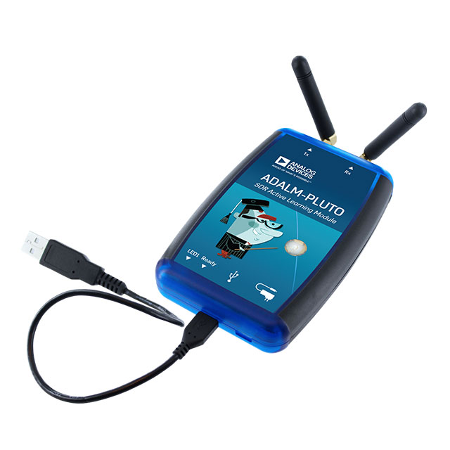
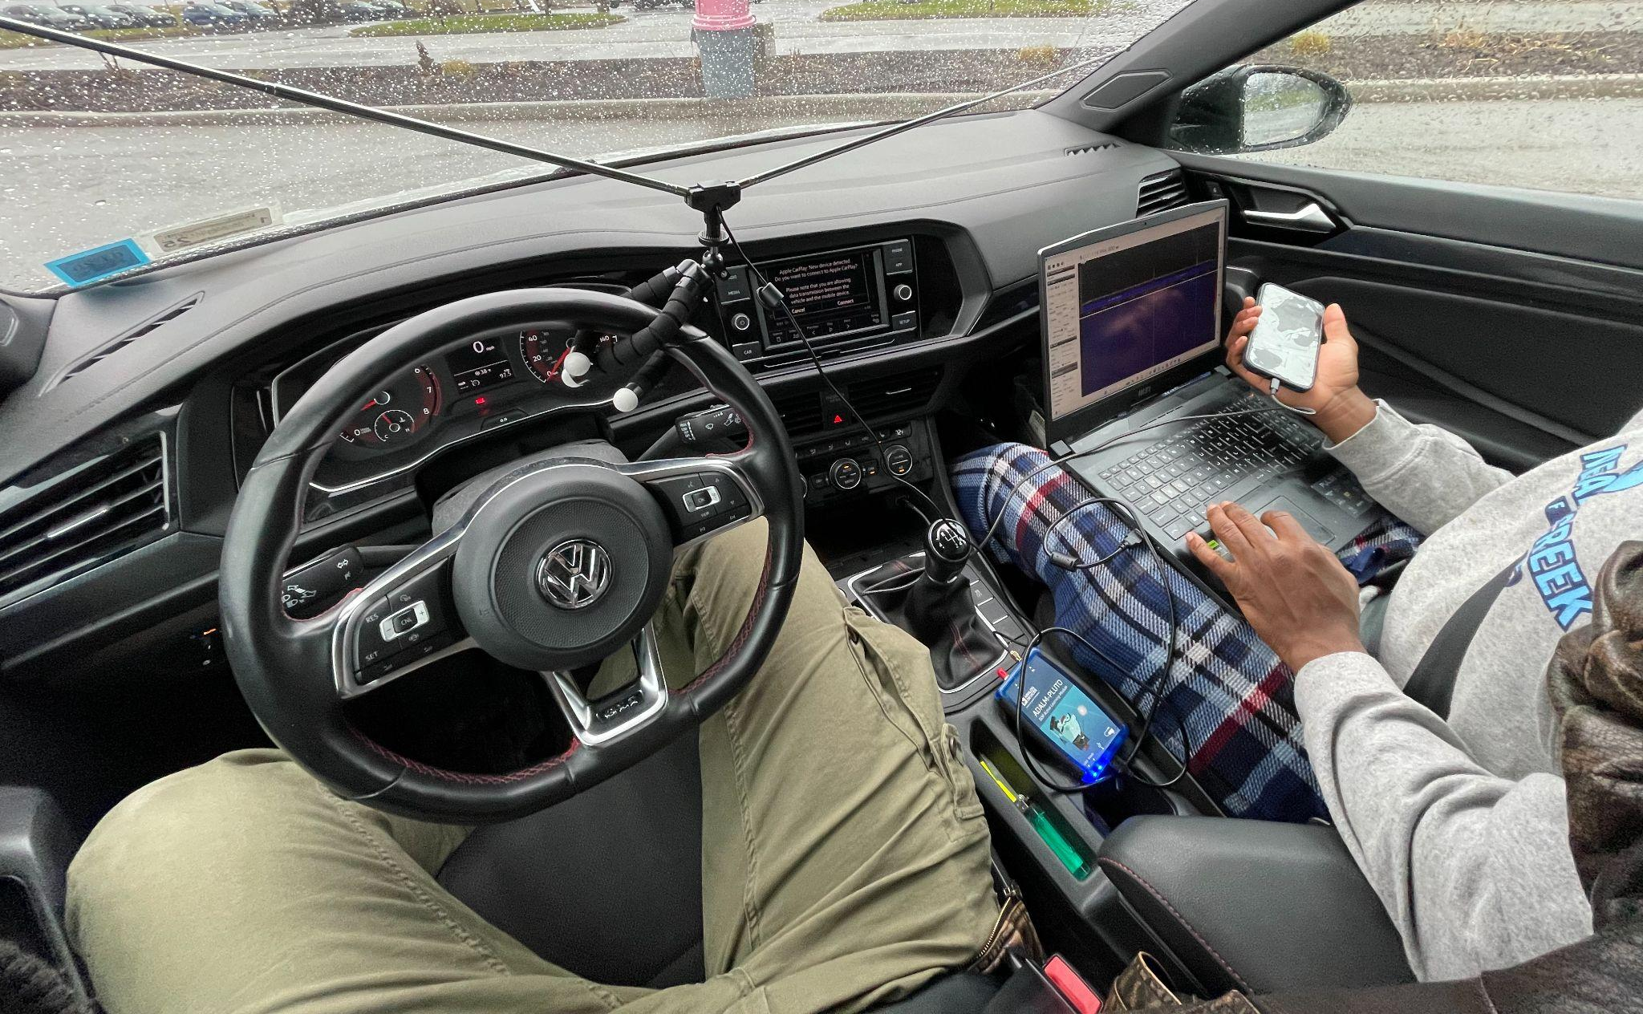
Hardware
Windows laptop
ADALM-PLUTO
Dipole antenna

Slide 5
Software
SDR#
Also needed to install the PlutoSDR patch and modify the front-end code to make it compatible.
Pluto-USB driver
PuTTY
This software emulates a terminal and allows access to Pluto via serial connection instead of remote access with IP addresses.

Slide 6
Goal Parameters
Lab testing:
Use signal generator to make sure the SDR catches the desired frequencies
Practical testing:
Attempt to Listen to air traffic conversation live
Desired Frequency:
118-136 MHz

Slide 7
Challenges
Typically PLUTO cannot operate at such a low frequency
We hacked it lmao
Lab testing with frequency generator at 120MHz proved successful operation
Limited air traffic in the rochester airspace lead to limited testing opportunities for real world data
Exercise in patience

Slide 8
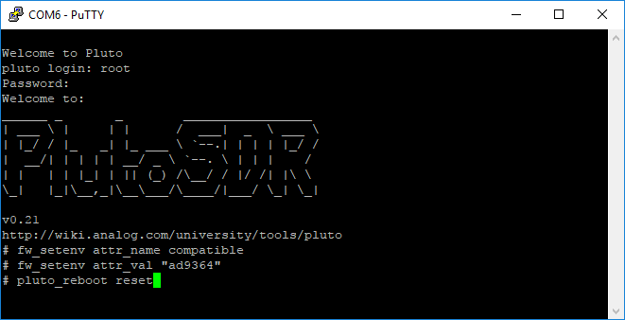
Hacking
The chip in the current run of Pluto is restricted to 325 MHz- 3800MHz and a bandwidth of 20 MHz. This chip and the unrestricted chip is similar. By changing a device string in Pluto it can mistake its current chip for the higher-end one. Below is the 3 lines of code needed.
The range was widened to
70 MHz - 6 GHz and 56MHz
Older version of SDRsharp had to used
To ensure the AD9363 chip would be
Recognized as AD9364 chip

Slide 9
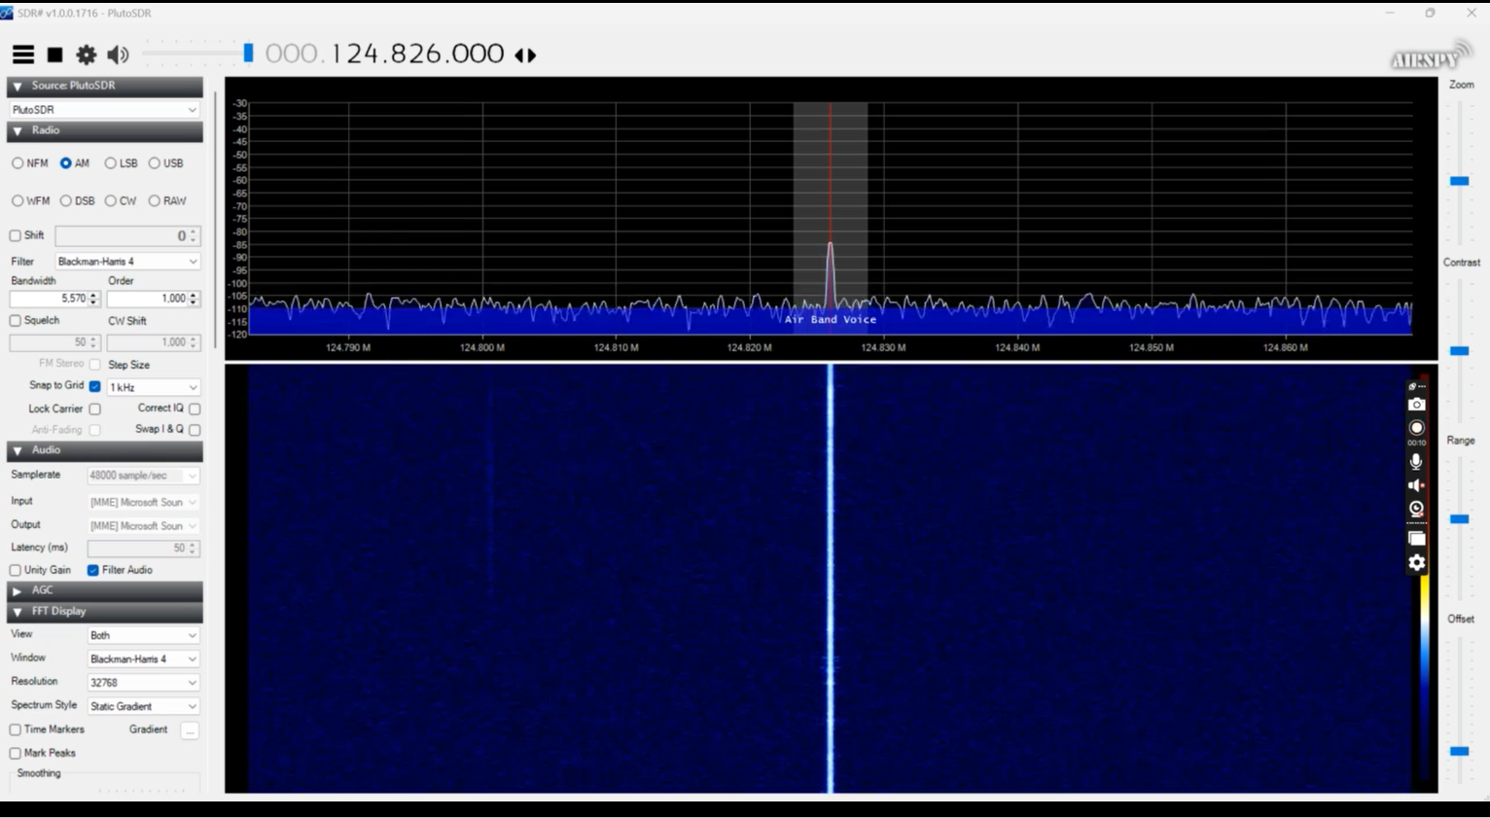
Testing
Drove to parking lot near Airport
Set up the Pluto and Dipole antenna
Set the modulation to AM
Observed signal at 124.824 Mhz

Slide 10
Results
The software successfully received air traffic signals and signals within the 92.5 MHz to 440 MHz range. However, the signals were weak and contained noticeable noise.
Despite this, the software effectively demodulated FM signals into clear, understandable audio. Additionally, metadata from FM stations was successfully recovered.
Testing for AM demodulation was not possible due to insufficient air traffic signals.

Slide 11
LIVE Demo

Slide 12
Sources
https://www.rtl-sdr.com/adalm-pluto-sdr-hack-tune-70-mhz-to-6-ghz-and-gqrx-install/
https://www.omnicalculator.com/physics/dipole

